Slide 1

Research, Development, Commercialization & Innovation
Request for Proposal (2024 / 2025)
Terms & Conditions

Slide 2
About The RFP
Objectives
  To identify and support the research, development, commercialization, and innovation in E&E technologies in the related application and market verticals
  To drive applied research, prototype development, and minimum viable product collaborative projects among industry and universities
  To support the development of the E&E sector in Malaysia
Key Requirements
  Focused on applied research or demonstration of minimum viable product or prototype
  Involves invention and intellectual property generation and licensing
  Involves high-skill technical knowhow and talent
  Completion of the project within 24 months
Eligibility
  The CREST R&D Grant is open to all applicants. However, the industry and university must be CREST members to be eligible for the funds. Find how to be a member at www.crest.my.

Slide 3
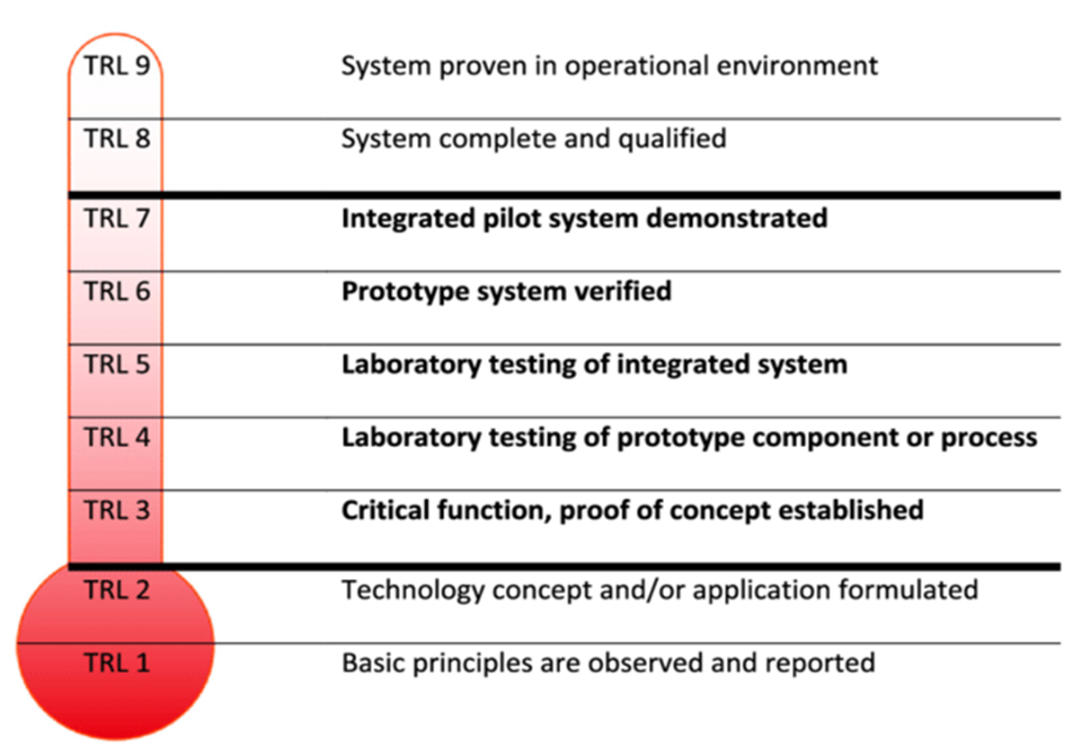
Basic Terms and Conditions
Research and Development | Commercialization and Innovation
Basic Criteria Research in any area relevant to the E&E industry Research on industrial applications TRL 5 to 7 | Basic Criteria Proof of Concept to develop Minimum Viable Product prototyping / services. Development of Minimum Viable Product prototyping / services proven in operational environment TRL 7 to 9
Partnership The research project requires a minimum partnership between a company and a university. There has to be at least one pairing of a company and university that is based in Malaysia.
Duration Duration of this collaborative project must be within 24 months.
Research Resource Full-time postgraduate student researchers funded must be Malaysian citizens. Student researchers cannot be project leaders. Research and Development Engineers or Officers must be Malaysian citizens. These engineers and officers cannot be project leaders. | Project lead must be from the company. Resources (engineers, etc.) fully/partially funded by CREST must be Malaysian citizen.

Slide 4
Basic Terms and Conditions
Research and Development | Commercialization and Innovation
Financial Arrangement Being a matching grant scheme, industry and university contributions (both in cash and in-kind) must be at least 50% of the total research budget proposed. For postgraduate students, CREST will pay for a stipend, the industry will provide a stipulated allowance share in the stipend, and the university shall cover the tuition fee and other costs. I-GRASP scheme is applicable (refer to the I-GRASP scheme). Post-Doctorate: RM6,500/month for a maximum of 2 years to be covered by CREST. For salary-based resources such as Engineer or Research Officer, CREST will provide up to the stated amount as per our guideline, and additional amounts such as additional salary component, provident fund, fringe benefits, and others shall be borne by the industry or university. CREST contributes to the salary of the engineering resources up to RM3,000 per month for the duration of the project, up to a maximum of 3 resources. Procurement of equipment and software will be managed by CREST. All equipment and software purchased using the CREST R&D Grant shall be owned by CREST after the project. Intellectual Property registration and incidental costs will be paid by CREST and registered under CREST. A supplementary sharing arrangement of the IP will be used to determine the share of the IP among collaborating parties.

Slide 5
Basic Terms and Conditions
Research and Development | Commercialization and Innovation
Eligible Cost Research resources in the form of graduate researchers or technical salaried personnel Research equipment, software, services, or material required Product certification, market, and clinical trial Intellectual property management Non-Eligible Cost Consultation fee Publication fee Legal fee Conference and travel fee Training fee Office/lab rental Office administration supplies | CREST contributes to the salary of the engineering resources up to RM3,000 per month for the duration of the project, up to a maximum of 3 resources.

Slide 6
Reporting and Progress Update Obligations
Research and Development | Commercialization and Innovation
Quarterly Progress Report Progress and financial report submissions need to be submitted every quarter. The report shall be accompanied by supporting documentation for each expense bank account statement as evidence. Technical report should be provided in presentation slide format and signed by all collaborators. Project Review and Audit Face-to-face or online review meetings and site visits will be arranged to review and approve scheduled disbursement once the project team meets milestones as per Research Grant Agreement. Change Management Any changes and deviations from the Research Grant Agreement will require a Change Request Form (CRF) and, thereafter, a review and approval by CREST. The latest approved changes will supersede milestones of the Research Grant Agreement. | Report and review (every 3 months) Progress and financial report submission every quarter. The report shall be accompanied by supporting documentation for each expense bank account statement as evidence. Technical report should be provided in presentation slide format and signed by all parties as evidence agreed.

Slide 7
Reporting and Progress Update Obligations
Research and Development | Commercialization and Innovation
Technical Publications Journal and conference technical publications shall be provided to CREST. As a guideline, MSc-level researchers are expected to produce a minimum of one publication, while PhD-level researchers are expected to produce a minimum of 3 publications. Intellectual Property Invention Disclosure to CREST for IP filing purposes. Market or Business Plan Business or market plan for products or services as required Project Closure Documents Final Report, Impact Information Report, and Project Outcome Report to be submitted at project closure. Maintaining Confidentiality Details of the project under the CREST R&D grant must not be shared with other parties without CREST’s permission.

Slide 8
Industry Graduate Research Assistant Scholarship Programme
(I-GRASP)

Slide 9
I-GRASP (Detailed contribution)
Postgraduate | Monthly allowance payment for PhD and MSc (max. 2 years) |  |  | Contribution by University | Maximum period of funding (months)
 | Maximum contribution by CREST | Maximum contribution by Company | Fixed amount of Allowance
PhD | RM3,500.00 | RM800.00 | RM4,300.00 | Tuition fees | 36
MSc | RM2,500.00 | RM500.00 | RM3,000.00 |  | 24
Postgraduate | Minimum criteria
PhD | CGPA of 3.00 and above for Bachelor's degree in the relevant and related field.
MSc | CGPA of 3.00 and above for Bachelor's degree in the relevant and related field.
IMPORTANT NOTE:
PhD students enrolled in the R&D projects must complete his/her studies during the project completion.

Slide 10
Postgraduate Candidate
A non-employee post-graduate candidate must fulfill the criteria below:
Completed their Bachelor’s degree in the relevant and related field;
Is a registered full-time post-graduate student working on the Project;
Is not attached to any organization as an employee;
Is a Malaysian; and
Is recommended by the University and the Company of the Project.
Application Procedure
Prospective candidate is required to submit – an academic transcript, CV, letter of acceptance as a post-graduate student, and recommendation letters from the University and Company in the CREST project.
Application shall be submitted once the Research Grant Agreement is executed.
Successful applicant is required to enter into an agreement (I-GRASP Agreement) with CREST, the University, and the Company.
Payment Procedure
I-GRASP recipient will be paid through CREST R&D grant allocated at the allowances and study fee category.
I-GRASP recipient will be paid starting from the effective date of the Research Grant Agreement or the effective date of postgraduate candidature (whichever is later).

Slide 11
Service Obligation Bond
Payment Procedure
I-GRASP recipient will be paid through CREST R&D grant allocated at the allowances and study fee category.
I-GRASP recipient will be paid starting from the effective date of the Research Grant Agreement or the effective date of postgraduate candidature (whichever is later).
I-GRASP recipient is bonded to CREST.
The service obligation bonded period shall be equivalent to the duration of the recipient’s postgraduate study.
I-GRASP includes a student service obligation bond to CREST, which will be released to the Company or University upon request.
In the event of a request from the Company or the University, CREST shall transfer the bond to the requesting party. In the case where both the Company and University do not require the service of the postgraduate, CREST shall have the right to nullify the Service Obligation Bond.

